Slide 1
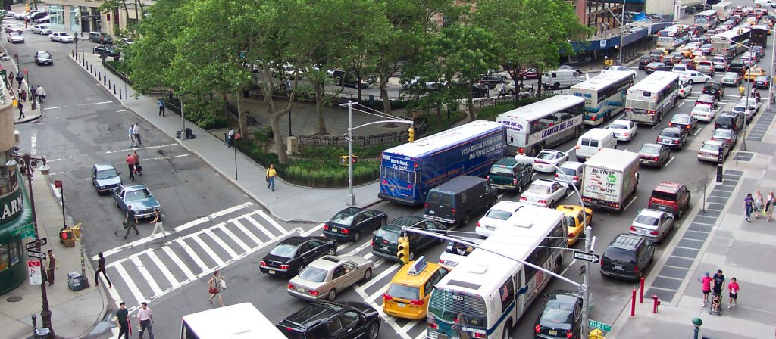
Systems of Linear Equations
Examples:
Traffic flows
Electronic circuits
least-squares optimization problems
Integral eq.
…
Ref: Ch.2 “Numerical methods in engineering with Python3”, Jaan Kiusalaas

Slide 2
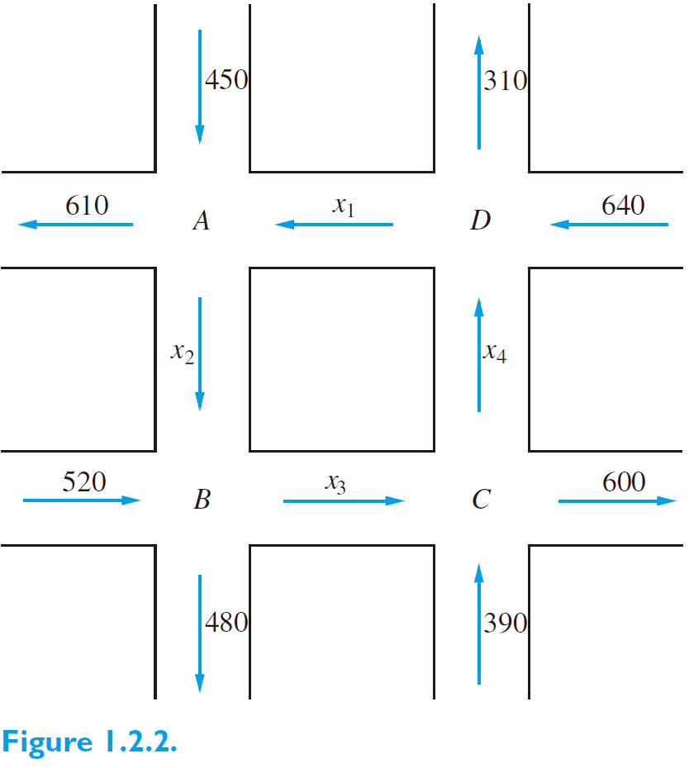
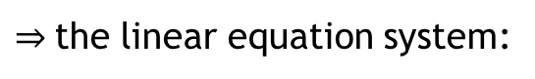
System of linear equations: traffic flows
problem
Ref: Ch1 “Linear Algebra with Applications”, Steven J. Leon, 9th ed., Pearson Education Limited.
Exercise_traffic-flow-1:
Flow in = Flow out
$⇒$the linear equation system:

Slide 3
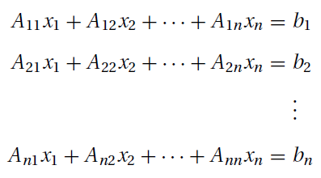
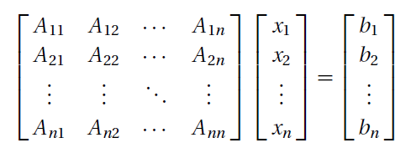
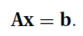
Linear systems
i.e.
or simply

Slide 4
System of linear equations: traffic flows
Ref: Ch1 “Linear Algebra with Applications”, Steven J. Leon, 9th ed., Pearson Education Limited.
Exercise_traffic-flow-1:
Flow in = Flow out
$⇒$the linear equation system:

Slide 5
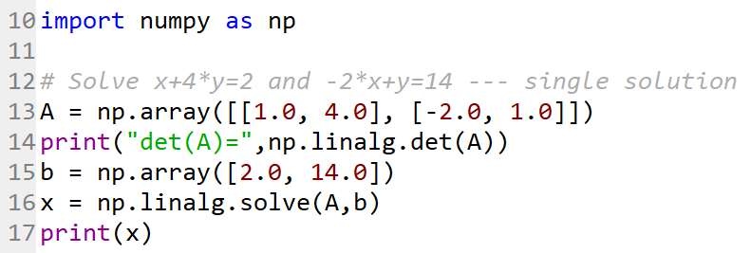
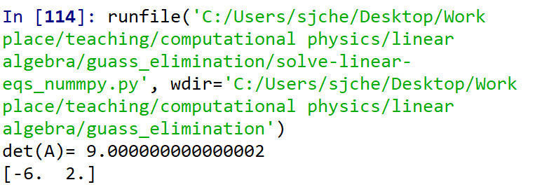
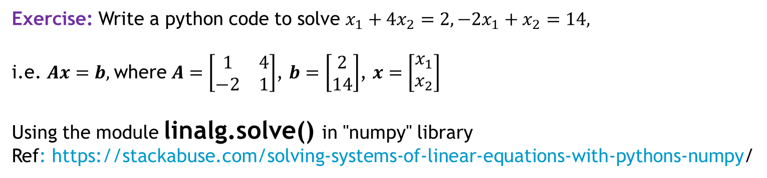
Solving a linear equation system using Python/Numpy: linalg.solve()
exercise
Exercise: Write a python code to solve $x_{1}+4x_{2}=2, −2x_{1}+x_{2}=14,$
i.e. $Ax=b,$where $A=\left[\begin{matrix}1 & 4 \\ −2 & 1\end{matrix}\right]$, $b=\left[\begin{matrix}2 \\ 14\end{matrix}\right]$, $x=\left[\begin{matrix}x_{1} \\ x_{2}\end{matrix}\right]$
Using the module linalg.solve() in "numpy" library
Ref: https://stackabuse.com/solving-systems-of-linear-equations-with-pythons-numpy/
C:\Users\sjche\Desktop\Work place\teaching\computational physics\linear algebra\guass_elimination\solve-linear-eqs_nummpy.py
Non-singular matrix → unique solution

Slide 6
Uniqueness of Solution
exercise
A system of n linear equations in n unknowns has a unique solution, provided that
the determinant of the coefficient matrix is nonsingular; that is, |A| $≠$ 0.
Refs: Ch2.1,”Numerical Methods in Emgineering with Python 3”, Jaan Kiusalaas, Cambridge Univ. Press
Ch1.5, “Linear Algenra with Applications”, Steven J. Leon, 8th ed. Pearson Education Limited.
Example: x-4y+6z=3, -2x+8y-12z=-6, and 2x-y+3z=1 does not have a unique solution.
Exercise: Write a simple code to compute the determinant of the coefficient matrix to judge the existence of solution.

Slide 7
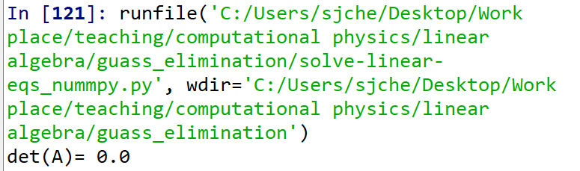
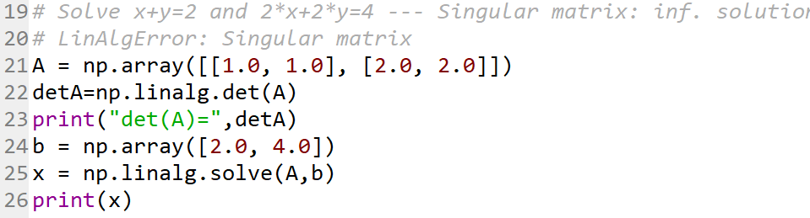
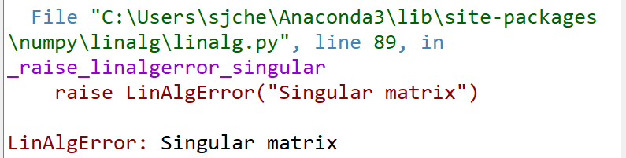
Solving a Linear equation system with singular matrix !?
exercise
Write a python code to solve $x+y=2$ and $2x+2y=4$ by using linalg.solve() ,
and see what happen?!
Singular matrix → linalg.solve() cannot handle !!

Slide 8
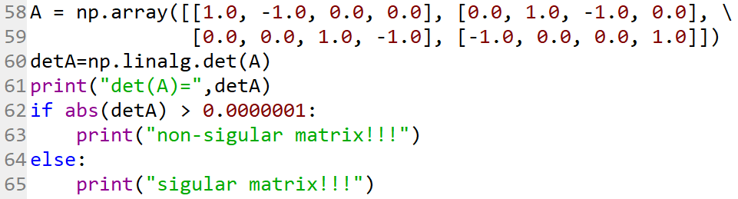
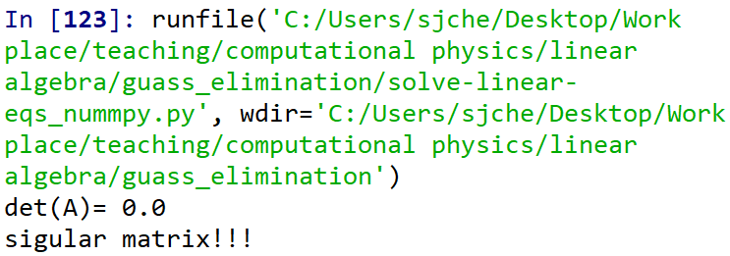
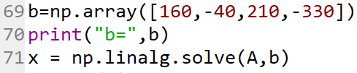
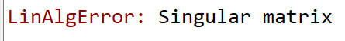
Singular matrix
!!

Slide 9
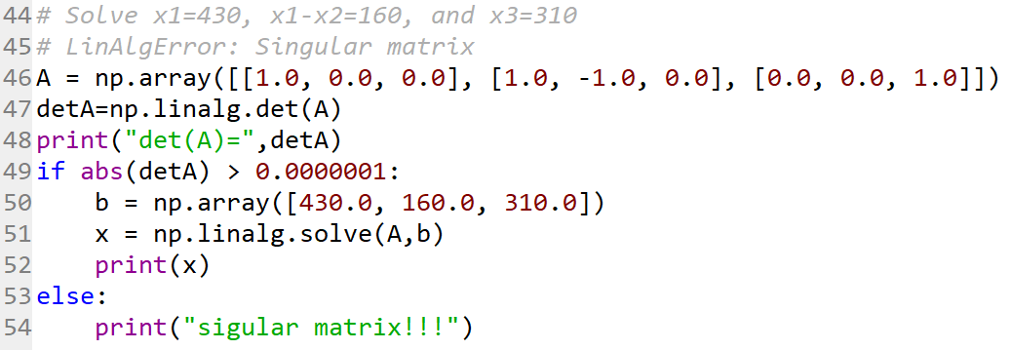
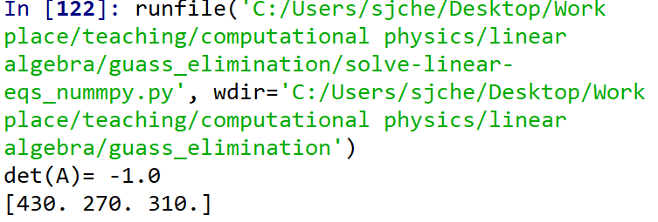


System of linear equations: traffic flows
Ref: Ch1 “Linear Algebra with Applications”, Steven J. Leon, 9th ed., Pearson Education Limited.
Exercise_traffic-flow-1:
With given $x_{4}=100⇒x_{1},x_{2},x_{3}=?$
$$x_{4}=100$$
In this way, the solution can be found but partially with your hands !!

Slide 10
System of linear equations: traffic flows
Ref: Ch1 “Linear Algebra with Applications”, Steven J. Leon, 9th ed., Pearson Education Limited.
Exercise_traffic-flow-1:
100
Let’s write our own code for fully numerically solving the linear system with the singular A !!
Source code: guassian-elimin.py

Slide 11
Solving linear systems: Gaussian elimination & back substitution

Slide 12
History of G.E.
Wiki (https://en.wikipedia.org/wiki/Gaussian_elimination):
The method of Gaussian elimination appears - albeit without proof - in the Chinese mathematical text Chapter Eight: Rectangular Arrays of The Nine Chapters on the Mathematical Art (九章算術). Its use is illustrated in eighteen problems, with two to five equations. The first reference to the book by this title is dated to 179 AD, but parts of it were written as early as approximately 150 BC.^{[1][2]} It was commented on by Liu Hui in the 3rd century.
The method in Europe stems from the notes of Isaac Newton.^{[3][4]} In 1670, he wrote that all the algebra books known to him lacked a lesson for solving simultaneous equations, which Newton then supplied. Cambridge University eventually published the notes as Arithmetica Universalis in 1707 long after Newton had left academic life. The notes were widely imitated, which made (what is now called) Gaussian elimination a standard lesson in algebra textbooks by the end of the 18th century. Carl Friedrich Gauss in 1810 devised a notation for symmetric elimination that was adopted in the 19th century by professional hand computers to solve the normal equations of least-squares problems.^{[5]}

Slide 13
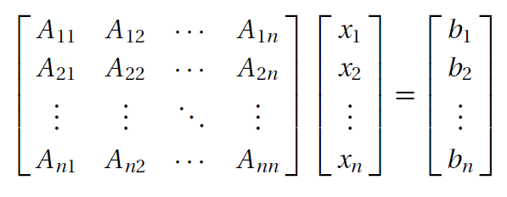
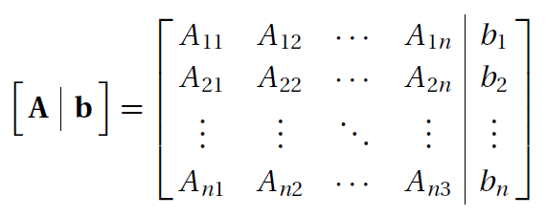
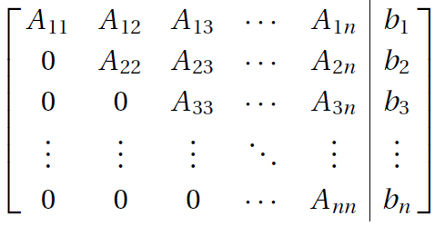
Gaussian elimination method
the augmented coefficient matrix:

Slide 14
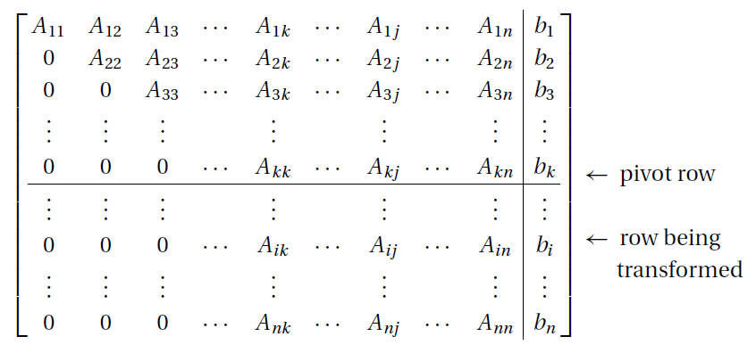
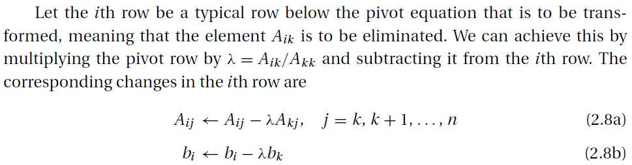
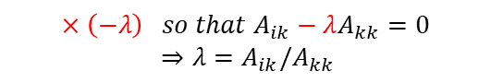
Gaussian elimination method: algorithm
k-th row
$$×\left(−λ\right) so that A_{ik}−λA_{kk}=0$$
$⇒λ=A_{ik}/A_{kk}$
i-th row
→0

Slide 15
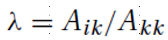
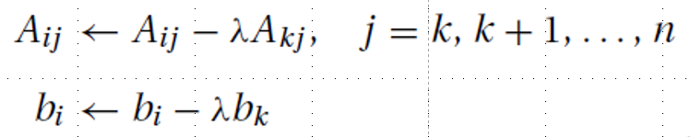
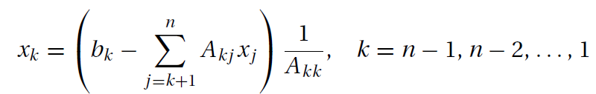
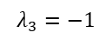
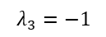
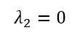

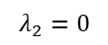
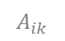
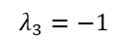
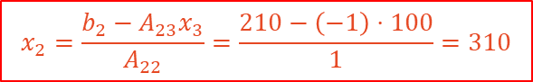
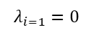

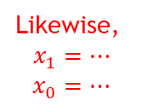
GE & BS : step-by-step derivation
$$A_{kk}=1$$
k=0
$$λ_{i=1}=0$$
i=k+1,..3
k=0,1,2
$$A_{ik}$$
i=1
$$λ_{2}=0$$
i=2
$$λ_{3}=−1$$
直接代入 $x_{3}=100$
i=3
k=1
$$λ_{2}=0$$
i=2
i=3
$$λ_{3}=−1$$
$$x_{2}=\frac{b_{2}−A_{23}x_{3}}{A_{22}}=\frac{210−\left(−1\right)⋅100}{1}=310$$
k=2
Likewise,
$$x_{1}=…$$
$$x_{0}=…$$
$$λ_{3}=−1$$
i=3

Slide 16
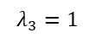
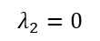
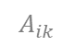
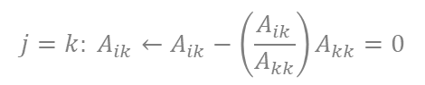
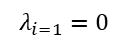
GE: code
Gaussian elimination:
Algorithm:
k=0
$$λ_{i=1}=0$$
i=k+1,..3
$$A_{ik}$$
$$j=k: A_{ik}←A_{ik}−\left(\frac{A_{ik}}{A_{kk}}\right)A_{kk}=0$$
i=1
$$λ_{2}=0$$
i=2
$$λ_{3}=−1$$
i=3
k=0,1,2
k=1
$$λ_{2}=0$$
Python code:
i=2
$$λ_{3}=1$$
for k in range(0,n-1): #k=0,1,...n-2
for i in range(k+1,n): #i=k+1, k+2,..n-1
if a[i,k] != 0.0:
lam=a[i,k]/a[k,k]
a[i,k:n]=a[i,k:n]-lam*a[k,k:n] #a[i,k:n]=a[i,k],a[i,k+1]...a[i,n-1]
b[i]=b[i]-lam*b[k]
i=3
k=2
$$λ_{3}=−1$$
i=3

Slide 17
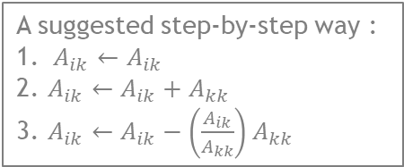
HW: write a GE code to make …
Home work 1.1 (03.10.2020)
A suggested step-by-step way :
1. $A_{ik}←A_{ik}$
2. $A_{ik}←A_{ik}+A_{kk}$
3. $A_{ik}←A_{ik}−\left(\frac{A_{ik}}{A_{kk}}\right)A_{kk}$

Slide 18
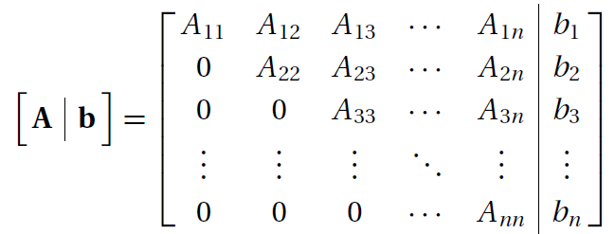
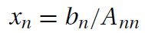
Back substitution
Demonstrate an example by hands !!
Start from

Slide 19
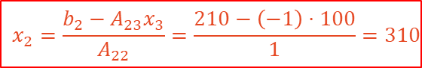
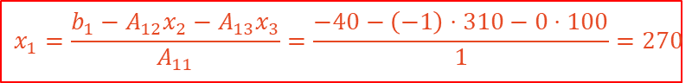
BS : step-by-step derivation
Algorithm:
直接代入 $x_{3}=100$
$$x_{2}=\frac{b_{2}−A_{23}x_{3}}{A_{22}}=\frac{210−\left(−1\right)⋅100}{1}=310$$
$$x_{1}=\frac{b_{1}−A_{12}x_{2}−A_{13}x_{3}}{A_{11}}=\frac{−40−\left(−1\right)⋅310−0⋅100}{1}=270$$
$$x_{0}=\frac{b_{0}−{A_{01}x_{1}−A}_{02}x_{2}−A_{03}x_{3}}{A_{00}}=\frac{160−\left(−1\right)⋅270−0⋅310−0⋅100}{1}=430$$

Slide 20
BS: code
Algorithm:
Code:
x[n-1]=b[n-1]/a[n-1,n-1] # note: ones needs to take care of denominator !=0
for k in range(n-2,-1,-1): #k=n-2,..,0
x[k]=(b[k]-dot(a[k,k+1:n],x[k+1:n]))/a[k,k]
numpy.dot:
Ref: C:\Users\sjche\Desktop\Work place\teaching\computational physics\Python\NumPy\creating arrays\arrays.py

Slide 21
GE + BS: code
Gaussian elimination:
for k in range(0,n-1): #k=0,1,...n-2
for i in range(k+1,n): #i=k+1, k+2,..n-1
if a[i,k] != 0.0:
lam=a[i,k]/a[k,k]
a[i,k:n]=a[i,k:n]-lam*a[k,k:n] #a[i,k:n]=a[i,k],a[i,k+1]...a[i,n-1]
b[i]=b[i]-lam*b[k]
Back substitution:
x[n-1]=b[n-1]/a[n-1,n-1] # note: ones needs to take care of denominator !=0
for k in range(n-2,-1,-1): #k=n-2,..,0
x[k]=(b[k]-dot(a[k,k+1:n],x[k+1:n]))/a[k,k]
C:\Users\sjche\Desktop\Work place\teaching\computational physics\linear algebra\guass_elimination\guassian-elimin.py

Slide 22
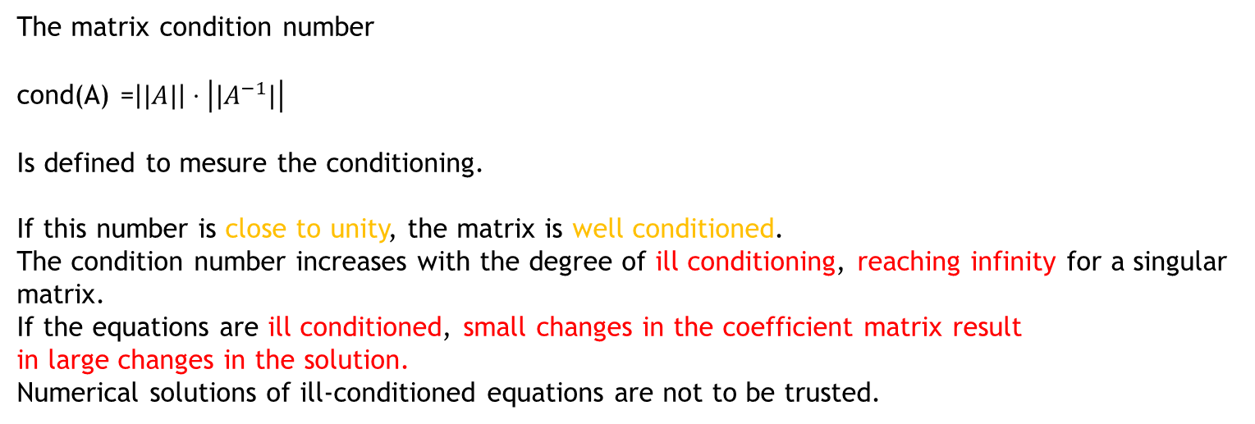
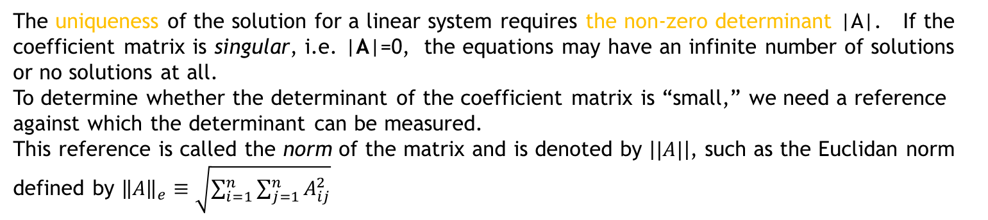
Conditioning
Ref: Ch.2.1 “Numerical methods in engineering with Python3”, Jaan Kiusalaas
The uniqueness of the solution for a linear system requires the non-zero determinant |A|. If the coefficient matrix is singular, i.e. |A|=0, the equations may have an infinite number of solutions or no solutions at all.
To determine whether the determinant of the coefficient matrix is “small,” we need a reference against which the determinant can be measured.
This reference is called the norm of the matrix and is denoted by $\left||A|\right|$, such as the Euclidan norm defined by ${\left\|A\right\|}_{e}≡\sqrt{\sum_{i=1}^{n}{\sum_{j=1}^{n}{A_{ij}^{2}}}}$
The matrix condition number
cond(A) =$\left||A|\right|⋅\left||A^{−1}|\right|$
Is defined to mesure the conditioning.
If this number is close to unity, the matrix is well conditioned.
The condition number increases with the degree of ill conditioning, reaching infinity for a singular matrix.
If the equations are ill conditioned, small changes in the coefficient matrix result
in large changes in the solution.
Numerical solutions of ill-conditioned equations are not to be trusted.

Slide 23
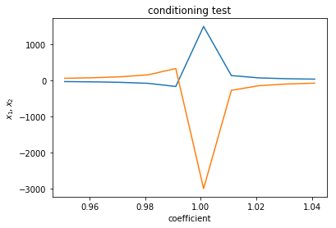
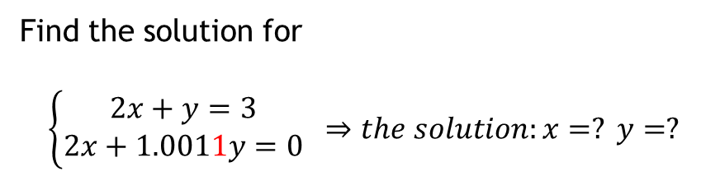

Conditioning: an ill-conditioned example
exercise
An ill-conditioned example:
$$\left\{\begin{matrix}2x+y=3 \\ 2x+1.001y=0\end{matrix}\right. ⇒the solution:x=1501.5, y=−3000$$
where $\left|A\right|=0.002$
Find the solution for
$$\left\{\begin{matrix}2x+y=3 \\ 2x+1.0011y=0\end{matrix}\right. ⇒the solution:x=? y=?$$
Using the module linalg.solve() in "numpy" library
Ref: https://stackabuse.com/solving-systems-of-linear-equations-with-pythons-numpy/
C:\Users\sjche\Desktop\Work place\teaching\computational physics\linear algebra\conditioned.py

Slide 24






Problem: Electric circuit
Home work 1.2 (due 03/24)
Ref:
Sec 1.2
HW: Find $i_{1}, i_{2}, i_{3}=?$

Slide 25
Transfer matrix

Slide 26







Transfer matrix: Marital population analysis
Ref:
Sec 1.4
$$x=\left(\begin{matrix}married \\ single\end{matrix}\right)$$
After 1 year:
After n year: $x_{n}=A^{n}x_{0}=$??
After 2 year:
C:\Users\sjche\Desktop\Work place\teaching\computational physics\linear algebra\marital status.py

Slide 27




Numpy: matrix power
C:\Users\sjche\Desktop\Work place\teaching\computational physics\Python\NumPy\matrix\matrix-pow_numpy.py

Slide 28

Matrix power
exercise
Exercise:
Write a code to calculate ${\left(\begin{matrix}0.7 & 0.2 \\ 0.3 & 0.8\end{matrix}\right)}^{3}=?$

Slide 29

Transfer matrix: Example 1
exercise
Sec 1.4
Exercise:
Numerically calculate and plot out the number of married women changed with the years from 1st to 10-th years
C:\Users\sjche\Desktop\Work place\teaching\computational physics\linear algebra\marital status.py

Slide 30


Vertical-cavity surface-emitting laser (VCSEL)
problem
Because VCSELs emit from the top surface of the chip, they can be tested on-wafer, before they are cleaved into individual devices. This reduces the fabrication cost of the devices. It also allows VCSELs to be built not only in one-dimensional, but also in two-dimensional arrays.
Ref: https://en.m.wikipedia.org/wiki/Vertical-cavity_surface-emitting_laser
distributed Bragg reflector (DBR)

Slide 31


Single dielectric interface: the boundary conditions
According the Maxwell’s eqs,
the boundary conditions of E & B at a charge- and current-free interface:
1
2

Slide 32


Single dielectric interface : the transfer matrix (TE-waves)
Consider the TE-waves:
Relating E and B via $E=vB=\frac{B}{\sqrt{με}}$ in the B.C.’s on the previous slide, one can derive

Slide 33







Single dielectric interface : the transfer matrix (…continued)
The B.C.:
$$≡D_{1}^{−1}D_{2}$$
$$E_{1z}$$
$$t⋅E_{1z}=E_{2z}$$
$$r⋅E_{1z}=E_{1z}′$$
Here, we assume $μ_{1}=μ_{2}$ and take the definition of refractive index $n_{i}=\sqrt{ε_{i}μ_{i}}. T$he reflection and transmission coefficients are derived as
$$r_{TE}=\frac{n_{1}−n_{2}}{n_{1}+n_{2}}$$
$$t_{TE}=\frac{{2n}_{1}}{n_{1}+n_{2}}$$
$$θ_{1}=\frac{π}{2}$$
Normal incident

Slide 34














A pair of dielectric layers : the transfer matrix (…continued)
$$D_{1}^{−1}D_{2}$$
$$D_{2}^{−1}D_{1}$$
$$P_{2}$$
$$P_{1}$$
$D_{i}=\left(\begin{matrix}1 & 1 \\ n_{i} & −n_{i}\end{matrix}\right)$ for normal incident light
$$⇒D_{1}^{−1}D_{2}=\frac{1}{2}\left(\begin{matrix}1+n_{2}/n_{1} & 1−n_{2}/n_{1} \\ 1−n_{2}/n_{1} & 1+n_{2}/n_{1}\end{matrix}\right)$$
$$n_{1}$$
$$n_{2}$$
$$n_{1}$$
$$E_{1z}(0)$$
$$E_{1z}(d)$$
$$E_{1z}′(0)$$
$$E_{1z}′(d)$$
x=0
x=$d_{2}$
x=${d_{1}+d}_{2}≡d$

Slide 35




Multiple pairs of dielectric layers : the transfer matrix (…continued)
$$E$$
Bragg Mirror
…….
$$r_{N}⋅E$$
i=1
i=2
i=N
[1] C.W. Wilmsen, H. Temkin, L.A. Coldren (eds.), Vertical-Cavity Surface-Emitting Lasers:
Design, Fabrication, Characterization, and Applications, (Cambridge Studies in Modern
Optics) (Cambridge University Press, Cambridge), (New Ed edition), 12 Nov 2001
[2] P. Yeh, A. Yariv, Optical Waves in Crystals: Propagation and Control of Laser Radiation (Wiley, New York, 1984)

Slide 36



Example: reflectance of DBR
Home work 1.3 (due 03/31)
Ref: Ch22, “Introduction to Optics”, by Frank L. Pedrotti et al.
HW: Calculate and plot the reflectance R versus the wavelength $λ=350,….850 nm$of normal incident light to a DBR composed of N=2,3…6 pairs of high- and low-index layers of $d_{i}=λ_{0}/{4n}_{i}$ with $n_{1}=2.35$ and $n_{2}=1.38$ and $λ_{0}=550nm.$

Slide 37



Problem: DBR with smooth interface
problem
Error function: https://mathworld.wolfram.com/Erf.html
Heaviside step func: https://mathworld.wolfram.com/HeavisideStepFunction.html
d1=d2=5
C:\Users\sjche\Desktop\Work place\teaching\computational physics\linear algebra\DBR-Mirror\error function.py

